Slide 1
Analysis of Blood loss predictive factors and transfusion practice in Percutaneous Nephrolithotomy of Kidney Stones
Balineni Priyanka
Hanus Andrew
Waingankar Varsha
October 16, 2017

Slide 2
Table of contents
Business case
Purpose
Summary of data set
Initial variable exploration
Descriptive statistics
Distribution of variables
S.M.A.R.T question
Scatterplots
Visualizations
Z scores
Conclusion

Slide 3
Business Case
Explore the relationship between variables that affect blood loss while performing PCNL - a minimal invasive procedure to remove stones from the kidney.

Slide 4
Purpose
PCNL is widely used practice for removing Kidney Stones with a demonstrated stone free rate up to 95%.
One of the most common complications while performing PCNL is Bleeding.
Even though not always needed injudicious Blood transfusion is performed in most cases.
Our goal is to identify the predictive factors of blood loss in PCNL procedure. Secondly, finding out the percentage of Blood Transfusion.

Slide 5
Summary of the Dataset
Sample Size : Randomly selected 85 patients (46 males 39 females)
Stone Size : Kidney Stones greater than 2cms only
Population : Patients (Men and Women over 18 years of age)
Data: Blood loss and Blood Transfusion data during PCNL
Research Paper: Firtantyo Syahputra, Ponco Birowo, Nur Rasyid, Faisal Matondang, Endrika Noviandrini, Maruto Huseini - Blood loss predictive factors and transfusion practice during percutaneous nephrolithotomy of kidney stoneshttps://f1000research.com/articles/5-1550/v1

Slide 6
Initial Variable Exploration …
Stone Burden : Diameter of stone in mm
Number of stones: Count of Kidney stones in a Patient
Baseline Serum Creatinine : Indicator of how well kidney is functioning.
RBC : Red Blood Cells
Baseline Hemoglobin : Hemoglobin concentration may be an important predictor of transfusion risk.
Baseline hematocrit %: Percentage of blood by volume that is composed of red blood cells.
BMI : Body mass index (18 to 25) normal
Amount of blood transfused peri-operative: Blood Transfusion done during surgery.
Total blood loss : The amount of blood loss during this procedure

Slide 7
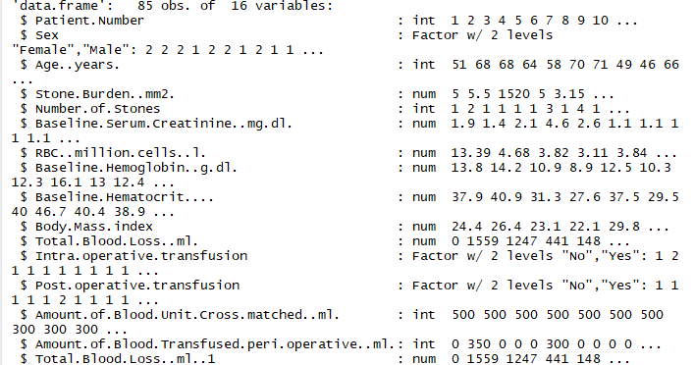
… Initial Variable Exploration

Slide 8
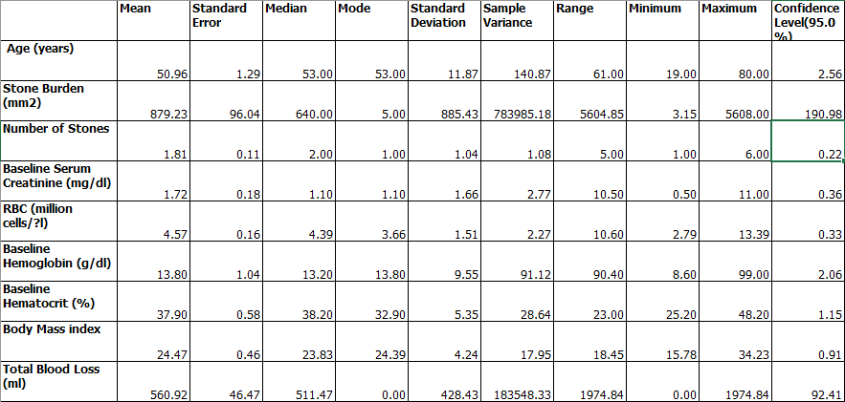
Descriptive Statistics

Slide 9
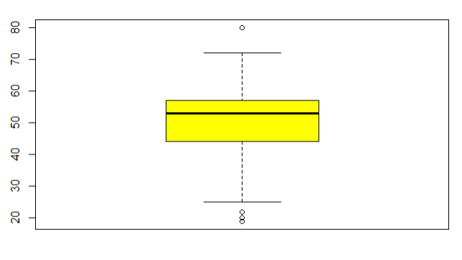
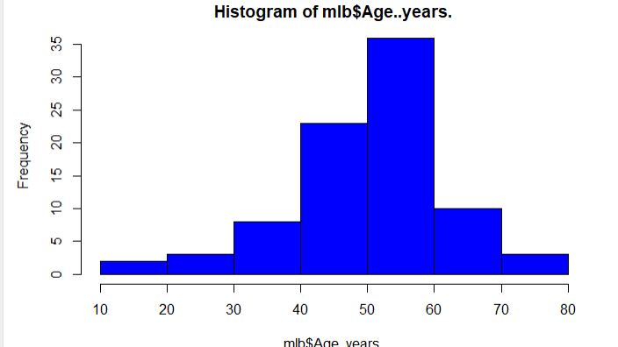
Age - Distribution

Slide 10
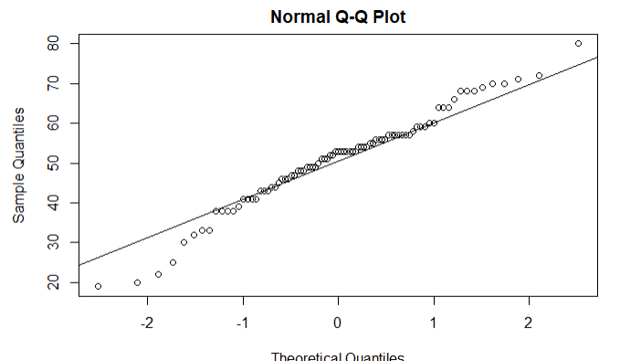
Age – Check for Normality
Age follows a light tailed distribution > Shapiro.Test(mlb$age..Years.) Shapiro-wilk normality test data: mlb$age. Years. W = 0.97486, p-value = 0.09531 (for 97.4% confidence interval significant p value= alpha=0.02) Null Hypothesis : Age is normally distributed (p> 0.02) fail to reject the null

Slide 11
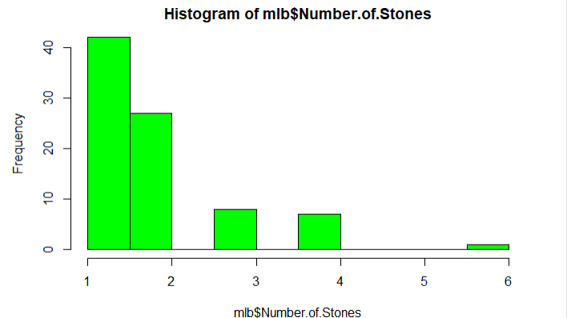
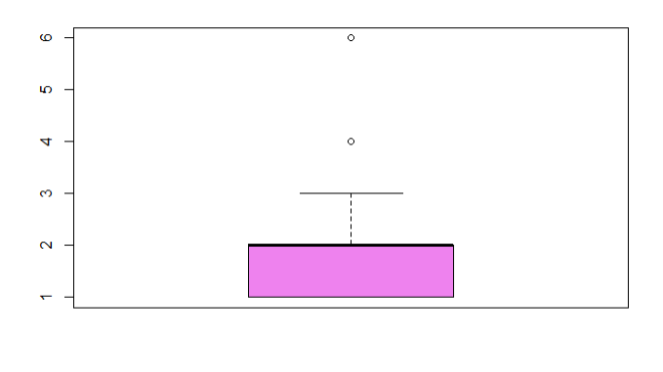
Number of Stones - Distribution

Slide 12
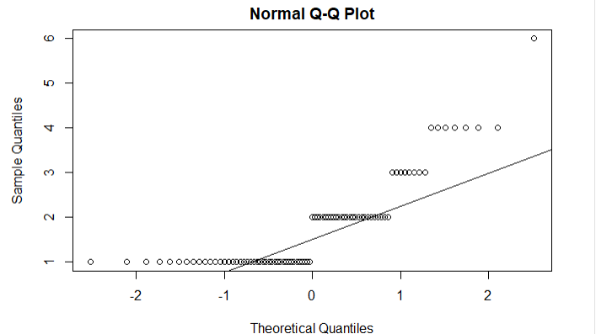
Number of Stones – Normality
The number of stones follows a multi modal distribution shapiro.test(mlb$Stone.Burden..mm2.) Shapiro-Wilk normality test data: mlb$Stone.Burden..mm2. W = 0.80297, p-value = 2.678e-09 significant p value(alpha) =0.19 2.678e -09<0.19 Reject the null hypothesis
Number of Stones is not a normal distribution

Slide 13
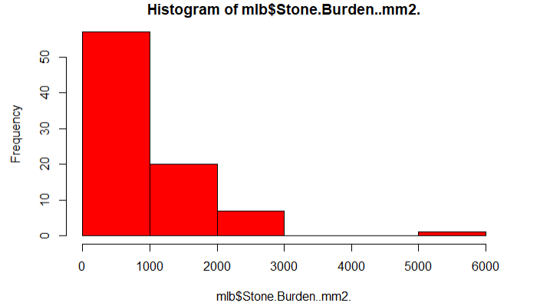
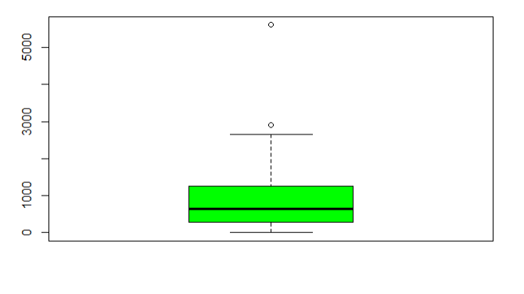
Stone Burden - Distribution

Slide 14
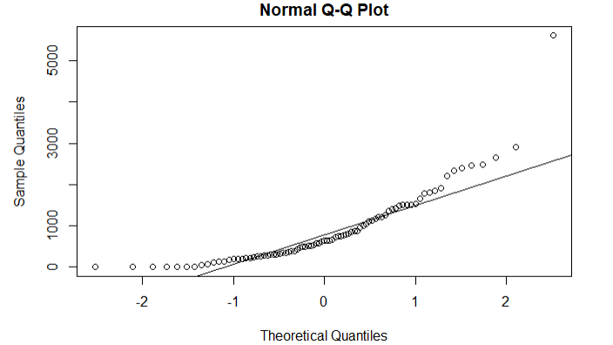
Stone Burden – Normality
The stone burden follows right skewed distribution Shapiro-wilk normality test data: mlb$stone.Burden..Mm2. W = 0.80297, p-value = 2.678e-09 E-09 indicates 10^(-9) 2.67/(10^(-9)) significant p value(alpha) should be 0.19 2.678e-09 < 0.19 (reject the null hypothesis)
Stone Burden is not normally distributed

Slide 15
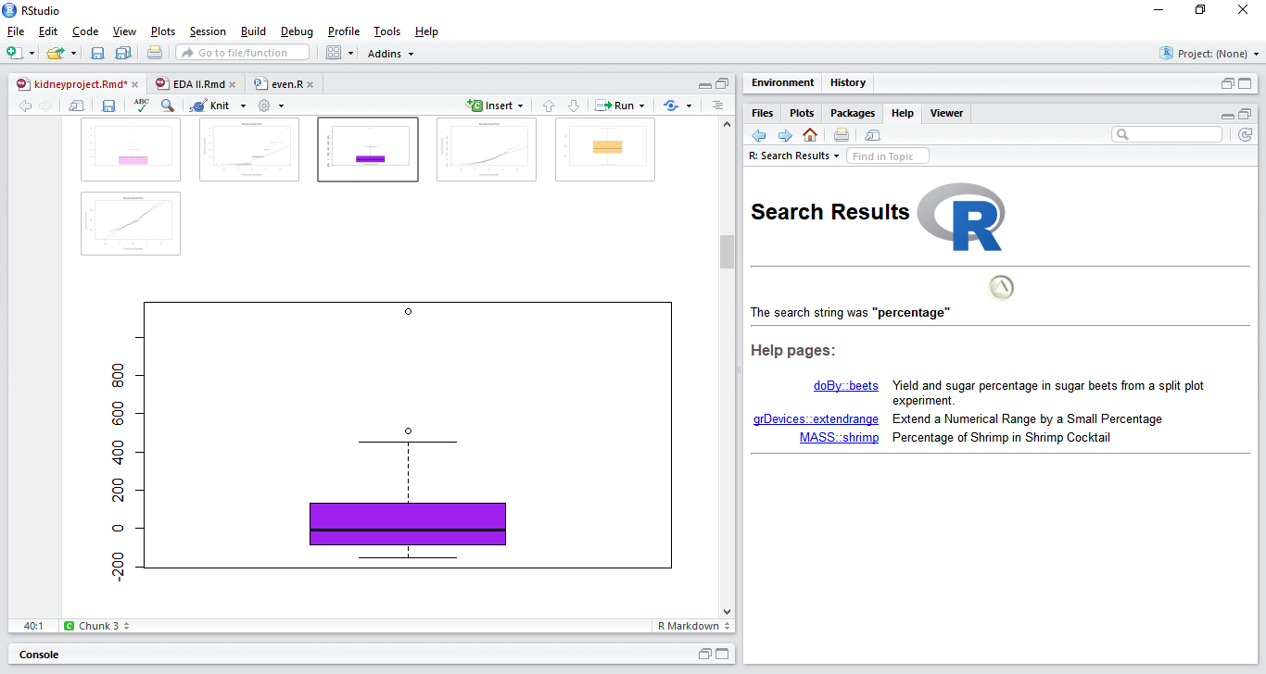
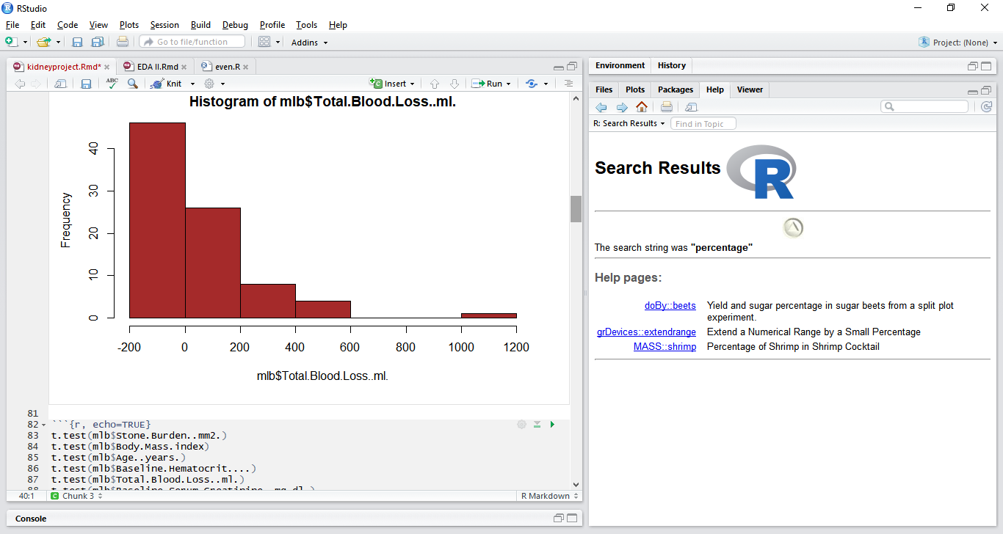
Total Blood Loss - Distribution

Slide 16
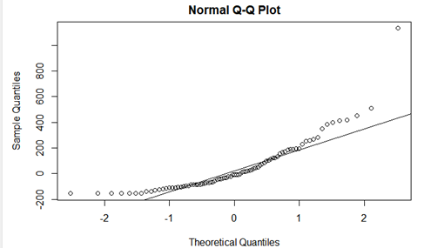
Total Blood Loss – Normality
Total blood loss follows a right skewed distribution > Shapiro.Test(mlb$total.Blood.Loss..Ml.) Shapiro-wilk normality test data: mlb$total.Blood.Loss..Ml. W = 0.80298, p-value = 2.681e-09 (alpha) significant p value should be 0.197 2.61e-09 < 0.197 (reject the null hypothesis)
The values for total blood loss are not normally distributed

Slide 17
SMART Question
What are the most influential factors of Blood Loss during PCNL surgical procedure?
Specific : About the patients who have Kidney Stone >2 cm
Measurable : Can be measured with the correlation coefficient
Achievable : The highest value of correlation coefficient when compared with all variables against blood loss
Relevant : Useful for researchers who are predicting the cause of blood loss during PCNL
Time bound : Sample data is already collected, so questions can be answered in a timely manner

Slide 18
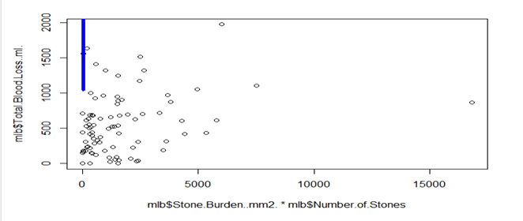
Stone Burden vs Blood Loss
Correlation between variables Stone Burden and Total Blood Loss are positively correlated with a correlation coefficient of 0.2487019

Slide 19
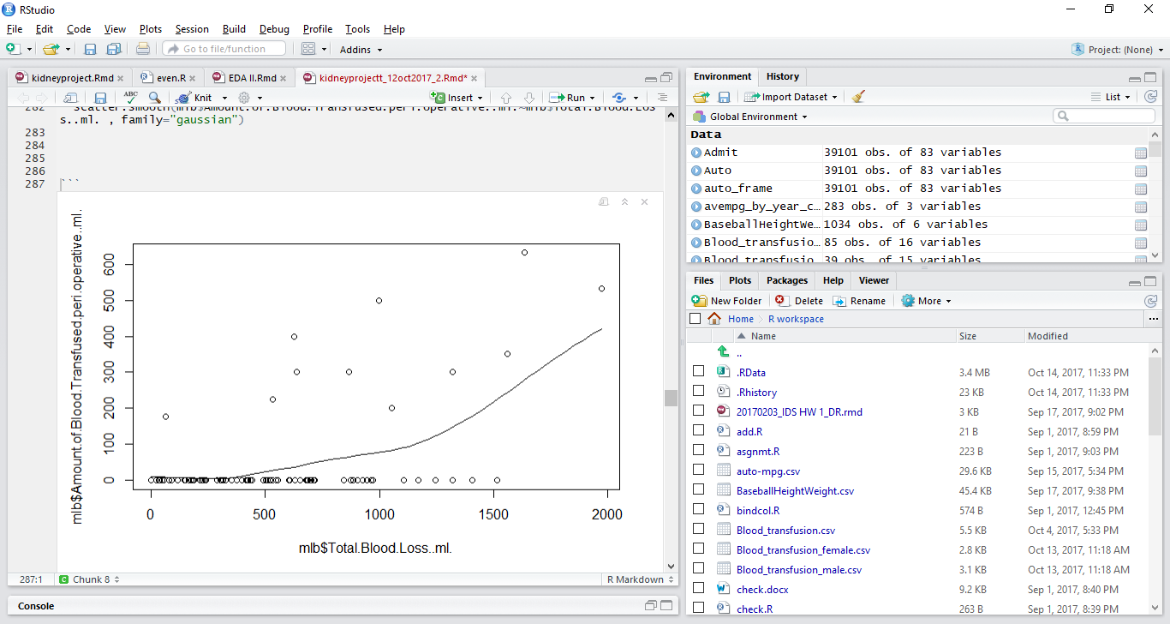
Blood Transfusion vs Blood Loss
Total blood loss and amount of blood transfused perioperative are positively correlated with a correlation coefficient of 0.505

Slide 20
Highest correlations within dataset
Total Blood Loss Correlations:
All Patients - Total Blood Loss and Amount of Blood Transfused peri-operative (ml) is +0.505779062
Female Patients - Total Blood Loss and Amount of Blood Transfused peri-operative (ml) is +0.64476018
Males Patients - Total Blood Loss and Age is +0.397718213

Slide 21
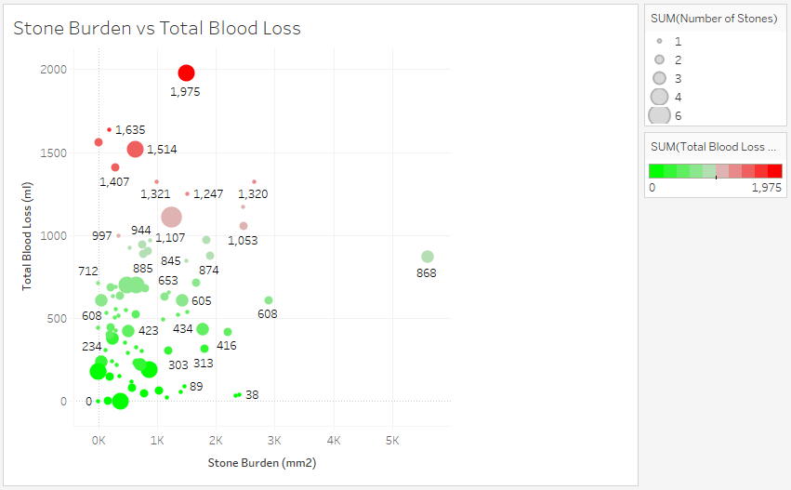
Factors affecting Blood Loss

Slide 22
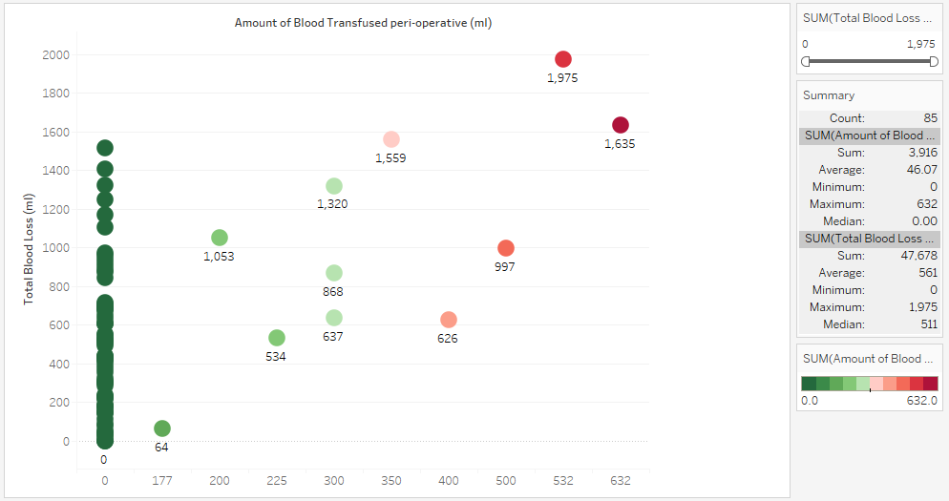
Blood Transfusion vs Blood Loss

Slide 23
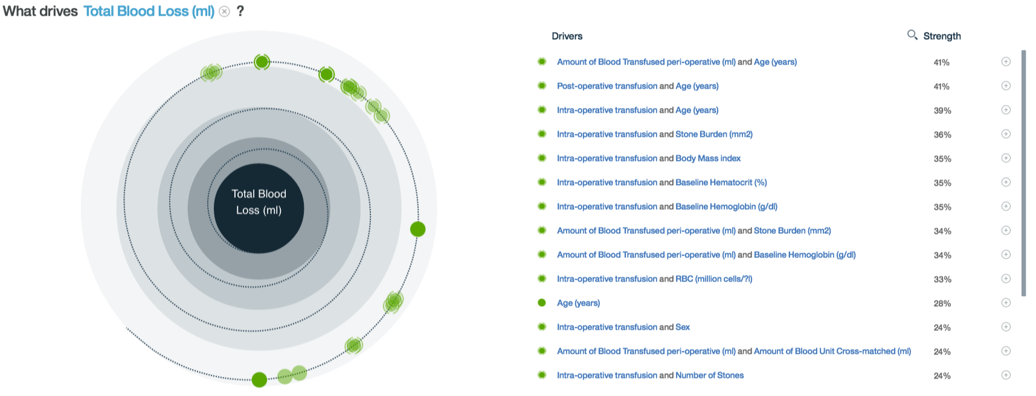
Total blood loss drivers

Slide 24
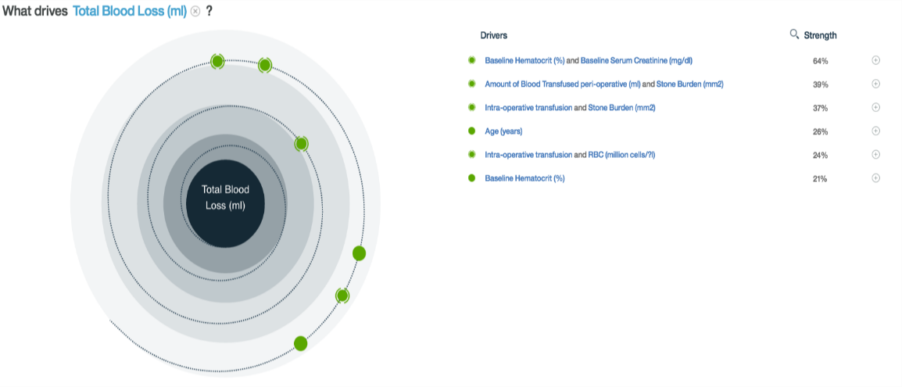
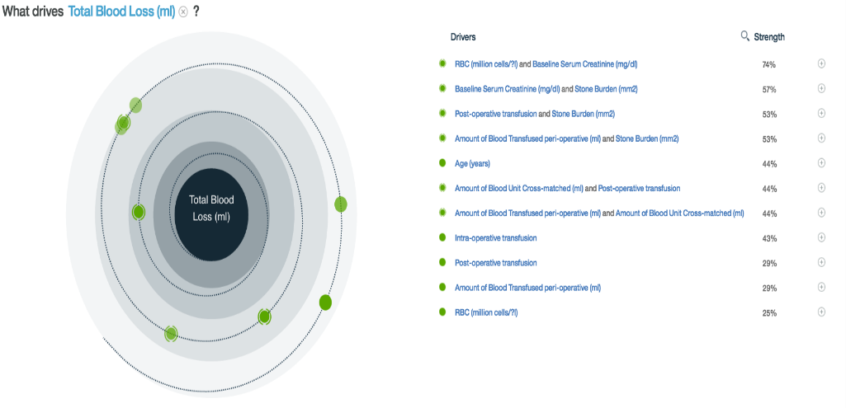
Differentiating the Total blood loss Drivers (Based on gender) (Based on gender)

Slide 25
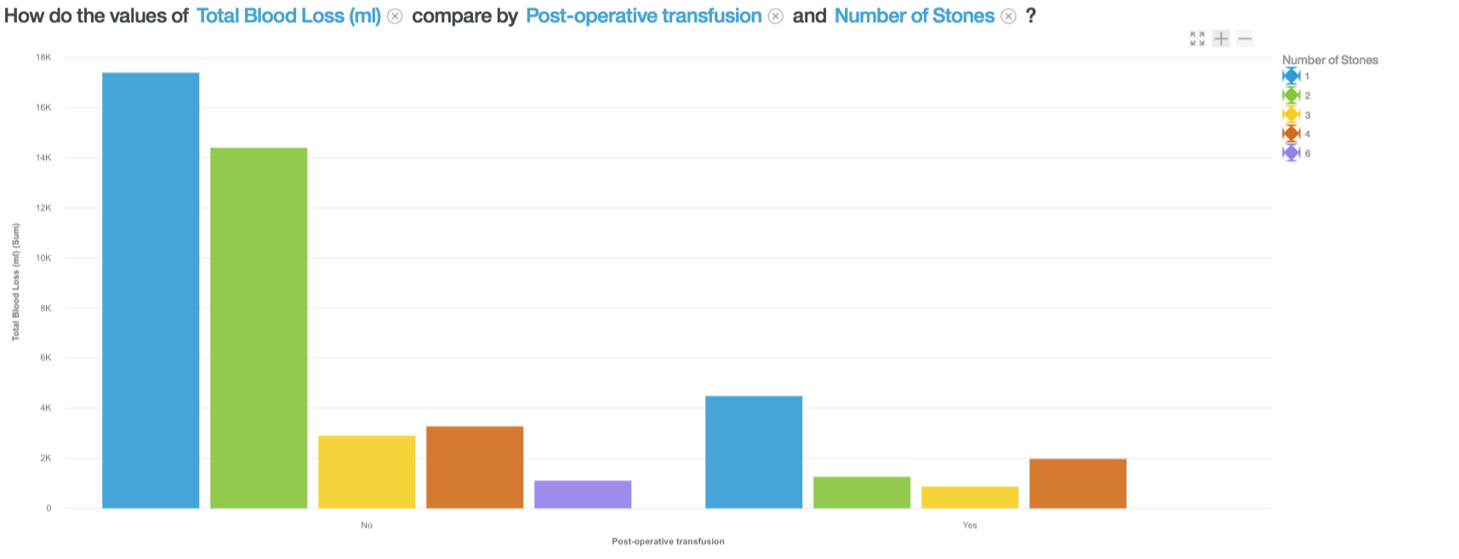
Multivariate look at Total blood loss (Based on gender)

Slide 26
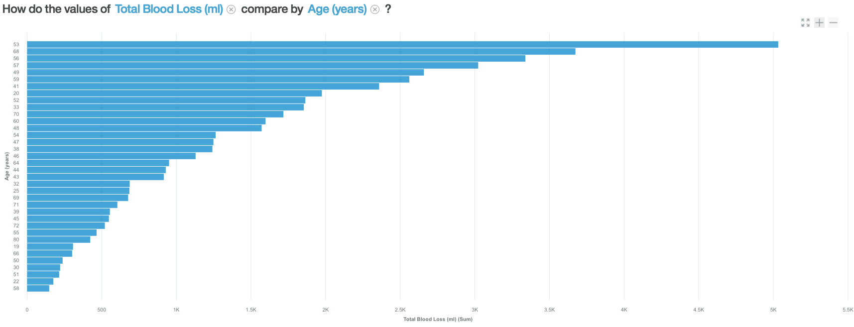
Relationship between patients Age and Total Blood Loss

Slide 27
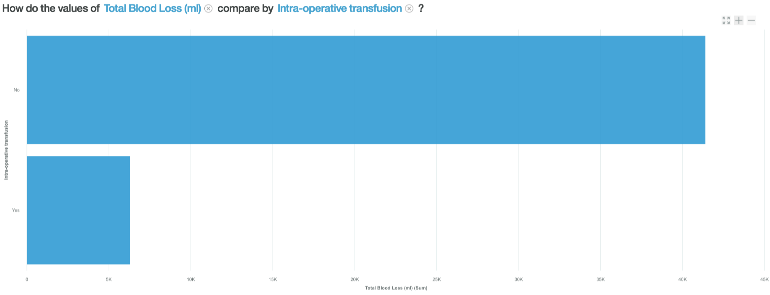
Total blood loss compared to intra-operative transfusion

Slide 28
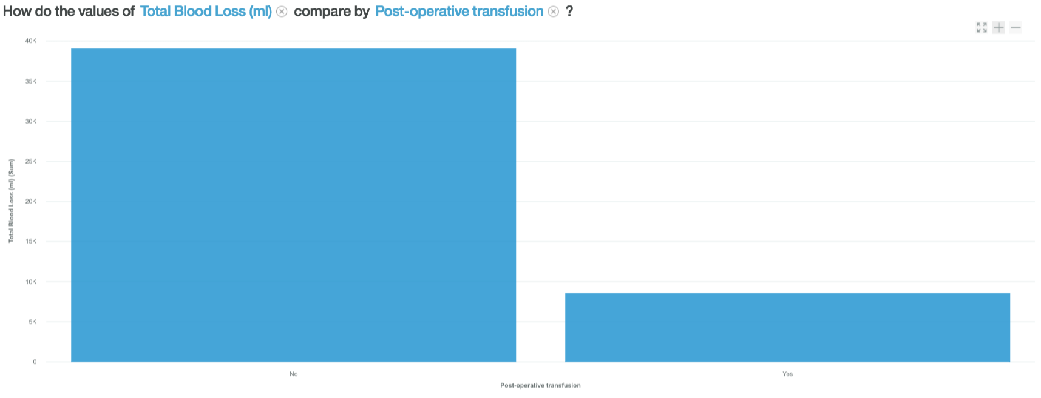
Total blood loss compared to post operative transfusion

Slide 29
Z Scores …
Z score for Stone Burden is 1.959964 for confidence interval 97.5% Average Stone Burden 879 188.2316 std error 690.9979 lower limit 1067.461 upper limit
Z score for Baseline serum creatinine 2.326348 for confidence interval 99% Average Baseline serum 1.71 0.3538281 std error 1.367584 lower limit 2.07524 upper limit

Slide 30
Z Scores …
Z score for Total blood loss 1.959964 for confidence interval 99% Average Total blood loss is 48 223.4185 std error -175.1045 lower limit 271.732 upper limit
Z score for Amount of blood units crossed matched 1.88 for confidence interval 97.5%
Average amount of blood units is 435.2
23.28 is std error
412.011 is lower limit
458.57 is upper limit

Slide 31
Conclusion
What are the most influential factors of Blood Loss during PCNL surgical procedure?
Using the correlation analysis Stone Burden is closely related total blood loss.
Bivariate analysis does not give much insight about the relationship
Multivariate analysis will help to better analyze the relationship.
Factors affecting variables in male and female could also vary.
So, the total blood loss may depend on more than one factor, unlike the hypothesis.(Multiple predictor variable)
How many folks got Blood Transfusion.
87% of the patients did not require blood transfusion, though they had blood loss.

Slide 32
Thank you!!!!
Questions?

